Slide 1
Co-embeddings for Student Modeling in Virtual Learning Environments
Milagro Teruel, Laura Alonso Alemany
Universidad Nacional de Córdoba, Argentina
UMAP 2018, Singapore

Slide 2
Motivation
Non-standard educational data formats:
Different domains
ITS vs MOOC
Expert effort is needed for generating/validating educational dataset labels

Slide 3
Proposed approach
Neural co-embeddings for representing:
Student activity
Course materials
No need of manually-generated metadata
Purely unsupervised method!

Slide 4
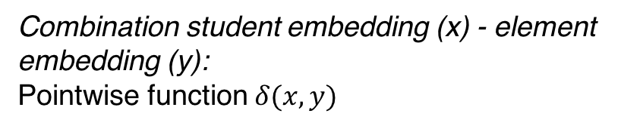
RNN architecture with co-embeddings
Convergence method:
Difference output - true labels → loss of the model over all examples, which is minimized using BPTT (and Truncated BPTT)
Combination student embedding (x) - element embedding (y):
Pointwise function $δ(x,y)$
Notes:
Recurrent Neural Network (RNN), which is designed to selectively remember some aspect of previously seen input.
BPTT: BackPropagation Through Time algorithm
Interpret hidden state after t interactions (ht ) of the RNN classifier as the embedding of the student at time T+1

Slide 5
Datasets
ASSISTments 2009-2010:
ITS logs
Pretext task: performance prediction
KDD Cup 2015:
MOOC dataset (XuetangX, Chinese MOOC)
Pretext task: dropout prediction

Slide 6
Experiment
3 type of RNN:
LSTM
E-LSTM
Input layer replaced by an embedding layer
Disjoint embeddings
CoE-LSTM (co-embeddings)
Model setup:
70% training
20% testing
10% validation (hyper parameters tuning)
Evaluation: Area Under the ROC curve (AUC) and RMSE
Notes:
LSTM: single layer of LSTM cells
Hyperparameters:
Embedding size
Hidden layer size
Number of events in the sequence
Dropout ration

Slide 7
Results Experiment 1: Neural co-embeddings for KT
Task: probability of success for every exercise, given all the previous interactions of the student.
Loss: sum of the cross entropy for all the interactions in the sequence
Data:
350,000 students interactions.
65% positive labels.
Problems with less than 5 interactions are filtered

Slide 8
Results Experiment 2: Neural co-embeddings for dropout
Task: Sequence classification.
Loss: average of the cross entropy.
Data:
Avg dropout: 79% → 19,072 students
39 different courses (dropout rate between 70 and 90%)
Notes:
Sequence classification > For every sequence, a single output is expected instead of one for each time step
Absence of student activity in the ten days following the end of the course
One model per course

Slide 9
Conclusions
Purely unsupervised method to model student behavior in learning platforms with joint embeddings of course elements and students
Co-embeddings can represent different latent dimensions
Skill levels in KT case
Engagement factors in case of MOOC
Co-embeddings “outperformed” disjoint and not-embedded representations.
CoE-LSTM models have a greater impact on the performance over courses with more class imbalance

Slide 10
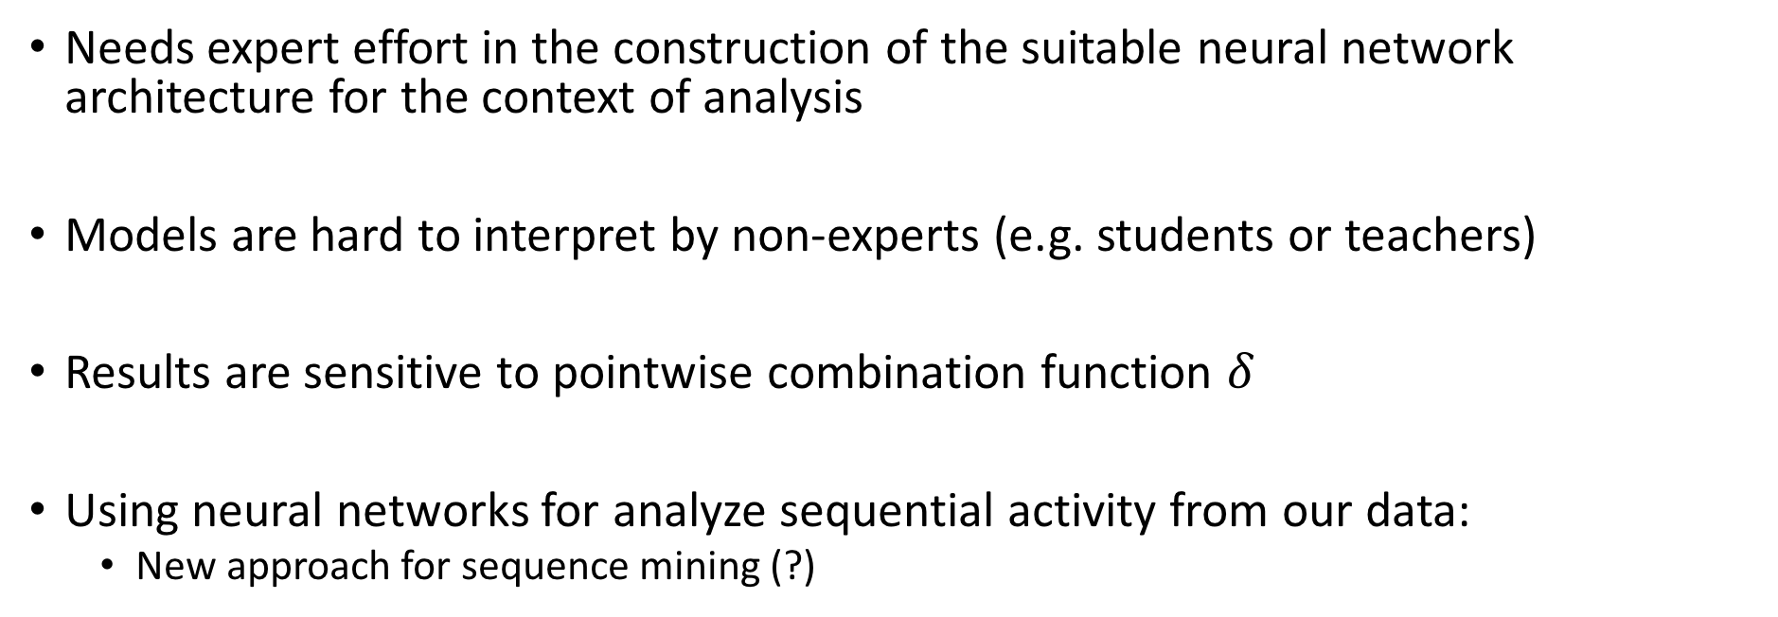
Limitations and Takeaway
Needs expert effort in the construction of the suitable neural network architecture for the context of analysis
Models are hard to interpret by non-experts (e.g. students or teachers)
Results are sensitive to pointwise combination function $δ$
Using neural networks for analyze sequential activity from our data:
New approach for sequence mining (?)

